Slide 1
History and Evolution

Slide 2
First recognized work on AI
McCulloch and Walter Pitts (1943)
The basic physiology and function of neurons in the human brain
The prepositional logic
The Turing’s theory of computation

Slide 3
Name of AI
1956 some of the U.S researchers got together and organized a two-month workshop at Dartmouth.
10 attendees
Allen Newell and Herbert Simon
Reasoning program, the Logic Theorist

Slide 4
First program that thought humanly
Newell and Simon’s early success.
General Problem Solver
It catered for a limited class of problems but it was found out that it addressed.
Very similar to that as humans

Slide 5
Development of Lisp
1958 In MIT AI Lab
McCarthy defined the high-level language Lisp
Dominant AI programming language.
Scarce and expensive computing resources were also a serious problem Programs with Common Sense
Advice Taker a hypothetical that can be seen as the first complete AI system

Slide 6
Microworlds
Marvin Minsky (1963), a researcher at MIT.
Limited problems that appeared to require intelligence to solve.
These limited domains became known as Microworlds

Slide 7
Microworlds
Statement:
If Ali is 2 years younger than Umar and Umar is 23 years old. How old is Ali? Answer:
Ali is 21 years old.

Slide 8
Researchers started to realize problems
Herbert Simon in 1957 said
“We now have machines that can think, learn, and create, like humans do. And these abilities are growing very fast. Soon, machines will be able to solve almost every problem that the human mind can solve.”

Slide 9
One of the problems was that early programs often didn’t have much knowledge of their subject matter, and succeeded by means of simple syntactic manipulations e.g. Weizenbaum’s ELIZA program (1965), which could apparently engage in serious conversation on any topic, actually just borrowed and manipulated the sentences typed into it by a human

Slide 10
NLP
Without context.
The famous retranslation of “the spirit is willing but the flesh is weak” as “the vodka is good but the meat is rotten” illustrates the difficulties encountered.

Slide 11
Intractable
Second kind of difficulty was that many problems that AI was trying to solve were intractable.
Most of the AI programs in the early years tried to attack a problem by finding different combinations in which a problem can be solved and then combined different combinations and steps until the right solution was found. This didn’t work always.

Slide 12
Limitations of Structures
Minsky and Papert’s book Perceptrons proved that although perceptrons could be shown to learn anything they were capable of representing, they could represent very little.

Slide 13
AI becomes part of Commercial Market
Expert system, R1, began operation at Digital Equipment Corporation (McDermott, 1982).
The program basically helped to configure the orders for new computer systems.
In 1981, the Japanese announced the “Fifth Generation” project, a 10-year plan

Slide 14
Neural networks reinvented
The algorithm was applied to many learning problem in computer science and the wide spread dissemination of the results in the collection
Parallel Distributed Processing (Rumelhart and McClelland, 1986) caused great excitement.
People tried out the back propagation neural networks as a solution to many learning problems and met great success.

Slide 15
Paradigm Shift, Expert Systems, People
Paradigm Shift, GPS, People realized that all the
realized that software programs can act as
problems can NOT be solved with the same
EXPERTS
approach
The name
First work in AI
“Artificial
Development of
Microworlds
1943
Intelligence”
Lisp
1963
coined
1958
1956
Paradigm Shift, ANN, People realized that
software programs can LEARN
AI a booming
Neural Networks
AI becomes an
Realization of
Industry TODAY
reinvented
Industry
hurdles
1986
1981

Slide 16

Applications

Slide 17
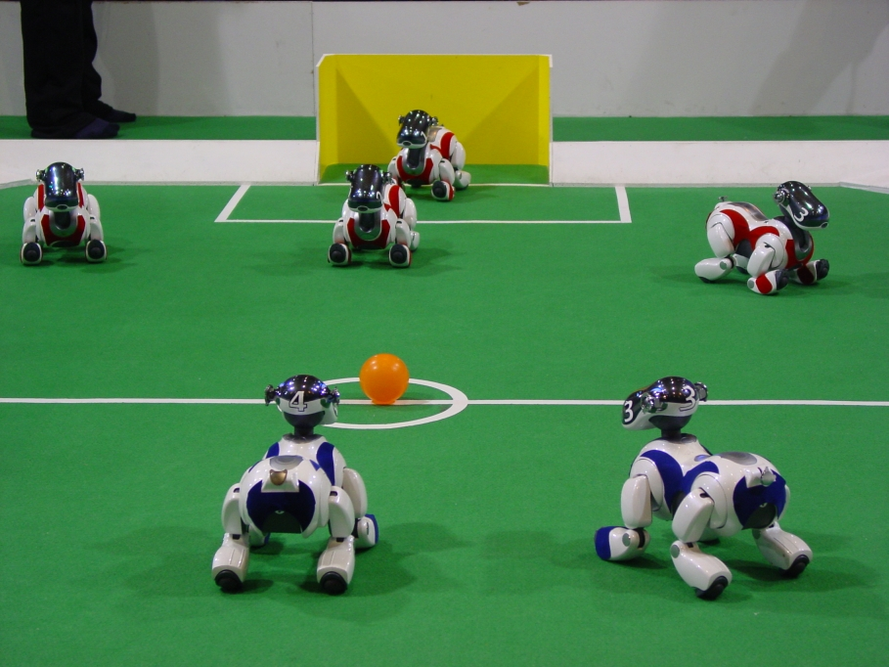
Robot Control

Slide 18
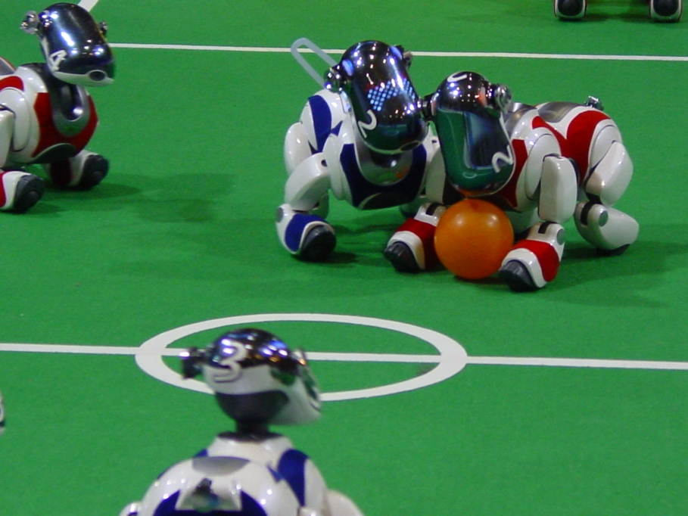
Robot Control

Slide 19
Applications
Games
Search
Computer vision
NLP
Expert Systems (MYCIN and XCON/R!)

Slide 20
Course Outline
Introduction
Expert Systems
Advanced
Topics
Problem
Solving
Uncertainty
Conclusion
Genetic
Learning
Algorithms
Knowledge
Representation
Planning
& Reasoning

